Slide 1
Technical SEO
xbi@2025

Slide 2
What is Technical SEO
Technical SEO is the practice of optimizing your website to help search engines find, crawl, understand, and index your pages.

Slide 3

Understanding crawling
A robots.txt file tells search engines where they can and can’t go on your site.

Slide 4
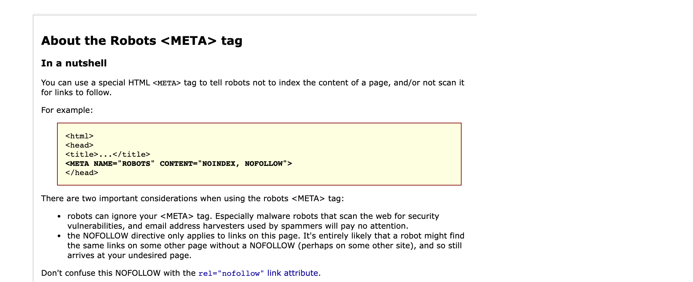
https://www.robotstxt.org/

Slide 5
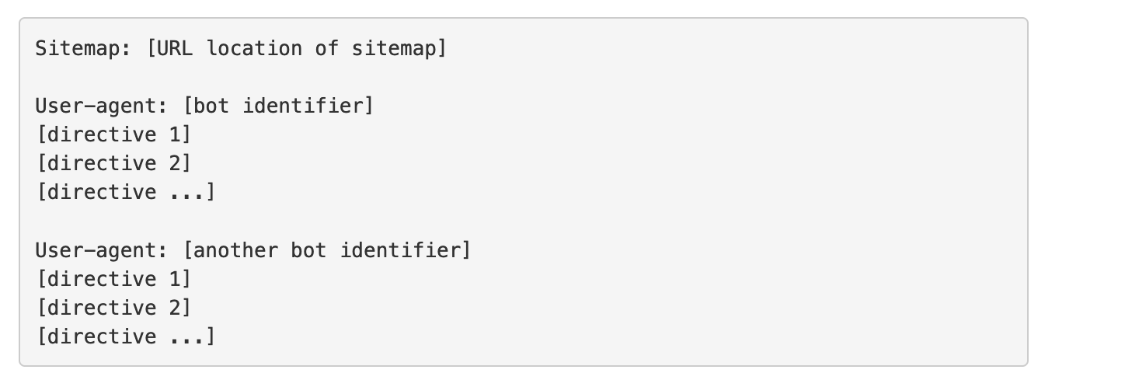
The robotstxt file

Slide 6
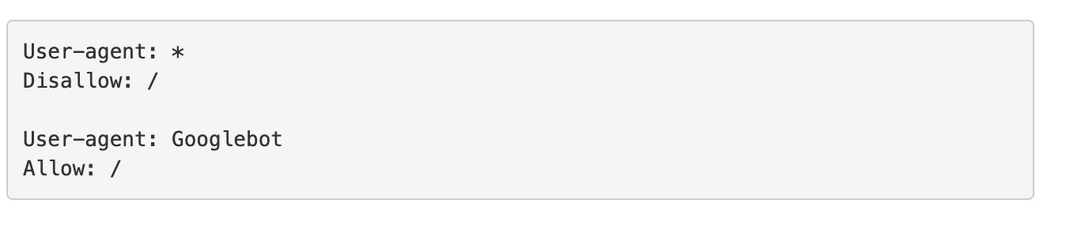
1: disable search bots
Google: Googlebot
Google Images: Googlebot-Image
Bing: Bingbot
Yahoo: Slurp
Baidu: Baiduspider
DuckDuckGo: DuckDuckBot

Slide 7
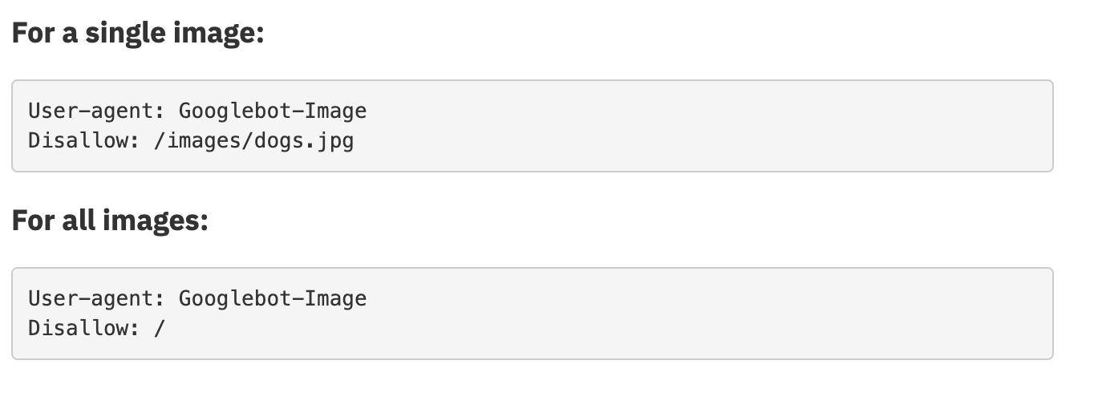
2 Prevent search engines from accessing

Slide 8
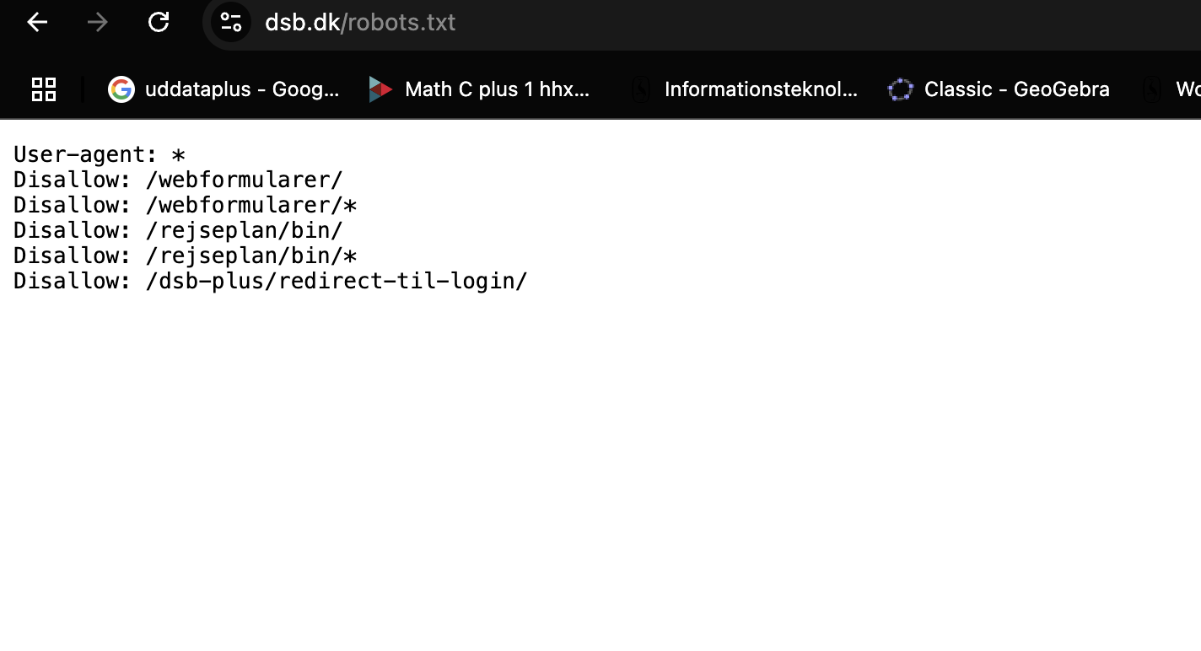
Robots.txt is the first place that Hackers look

Slide 9
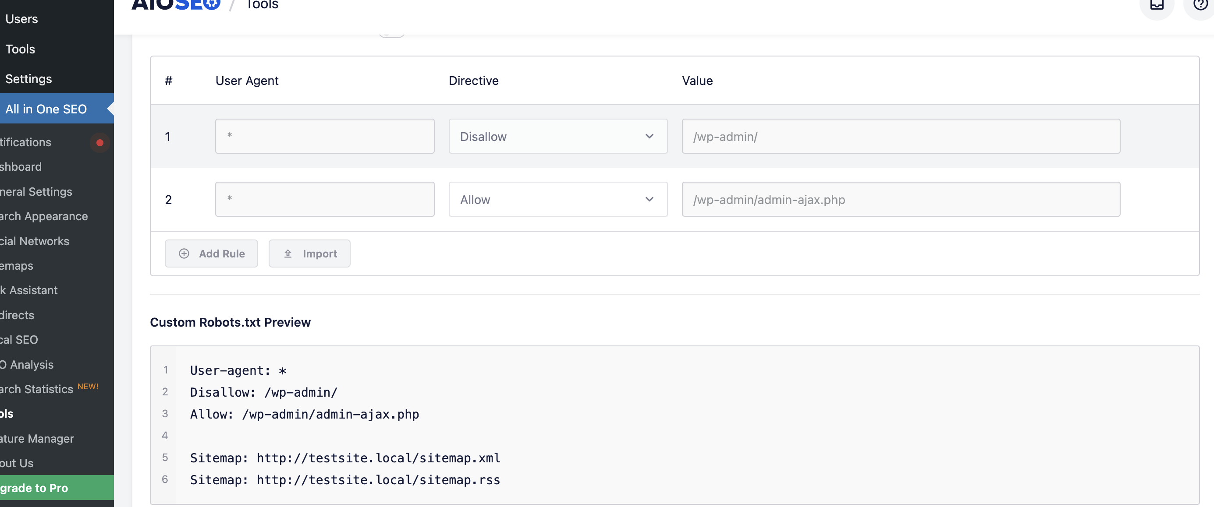
Robots.txt in WordPress (AIOSEO plugin)

Slide 10

index your web pages

Slide 11
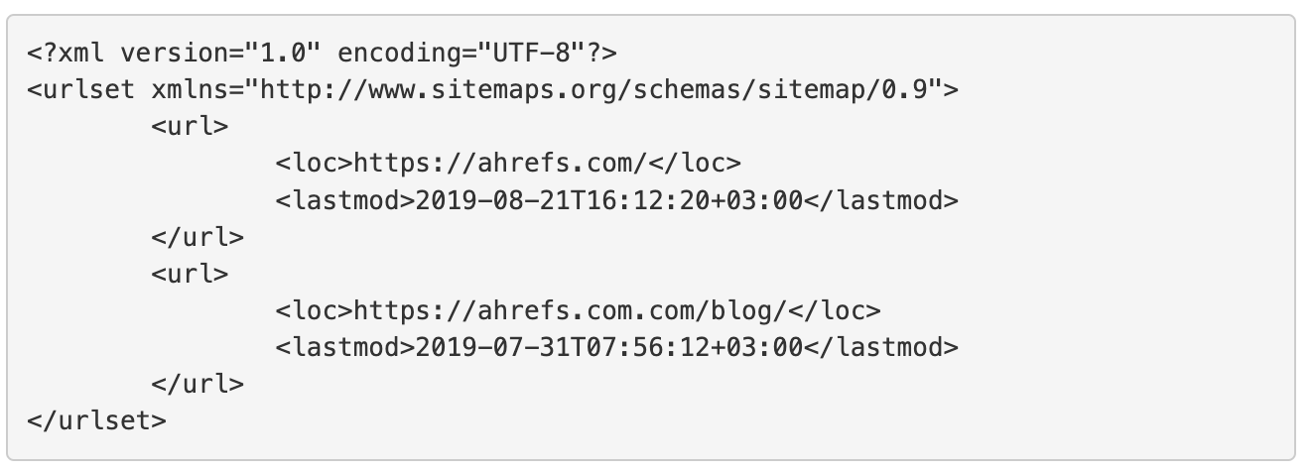
3 Sitemap

Slide 12
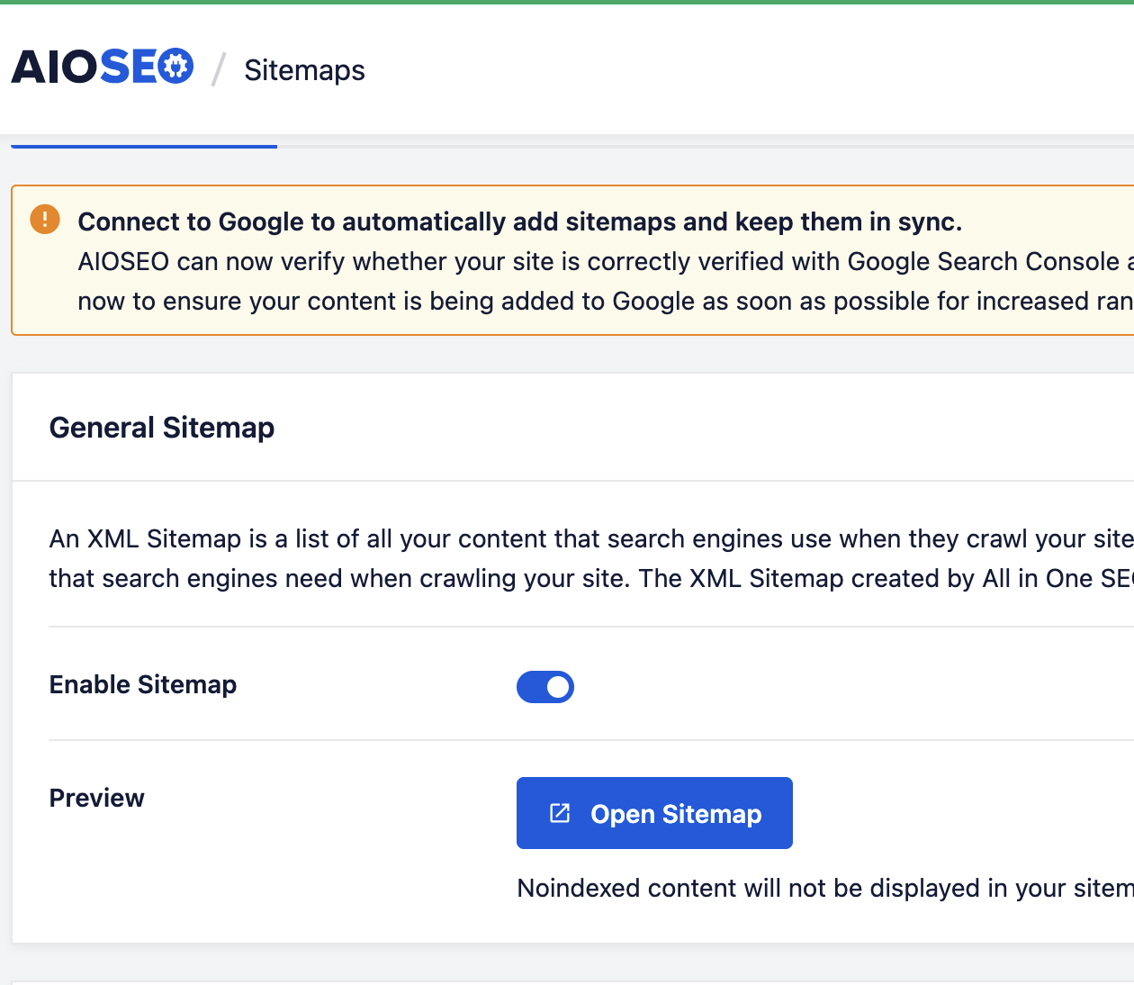
Site maps in WP

Slide 13

health and hygiene of your website

Slide 14
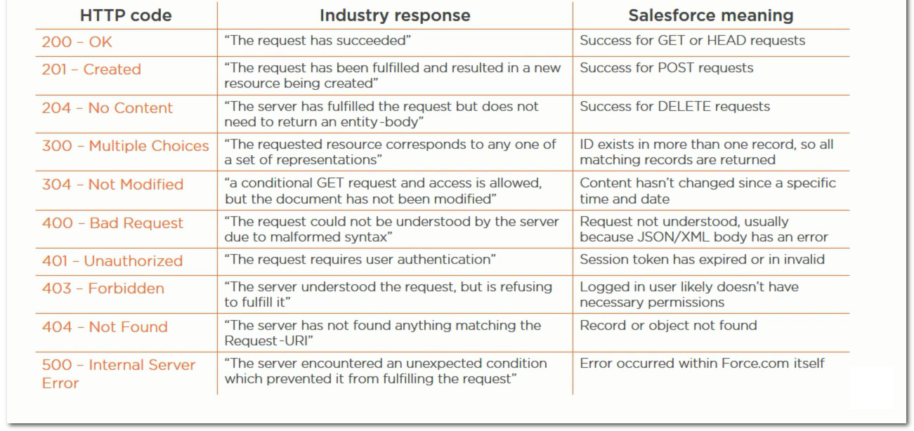
Response code

Slide 15
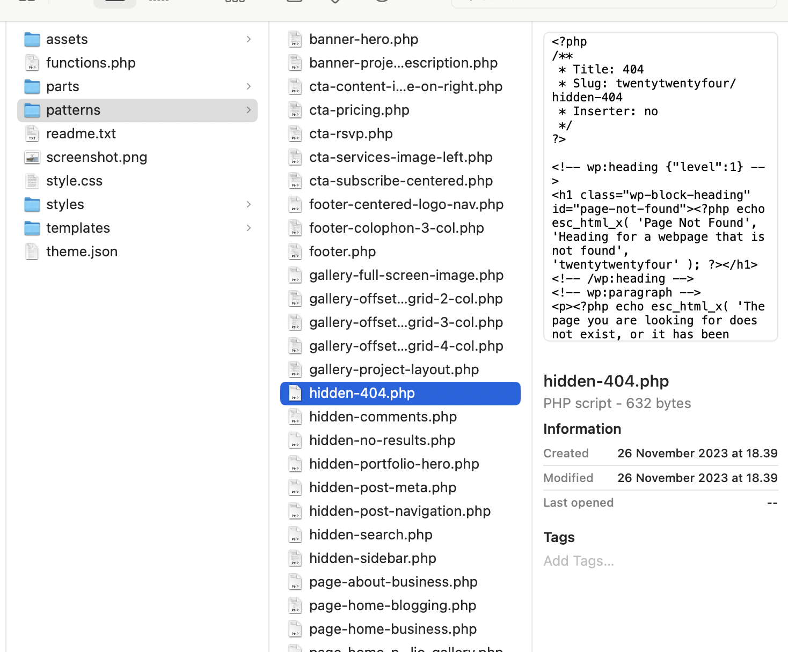
Internal 404s
WP
Twenty-twenty
Four theme

Slide 16
Note:
Do not edit diretly the 404.html and php file in VSCode
That will not work!

Slide 17
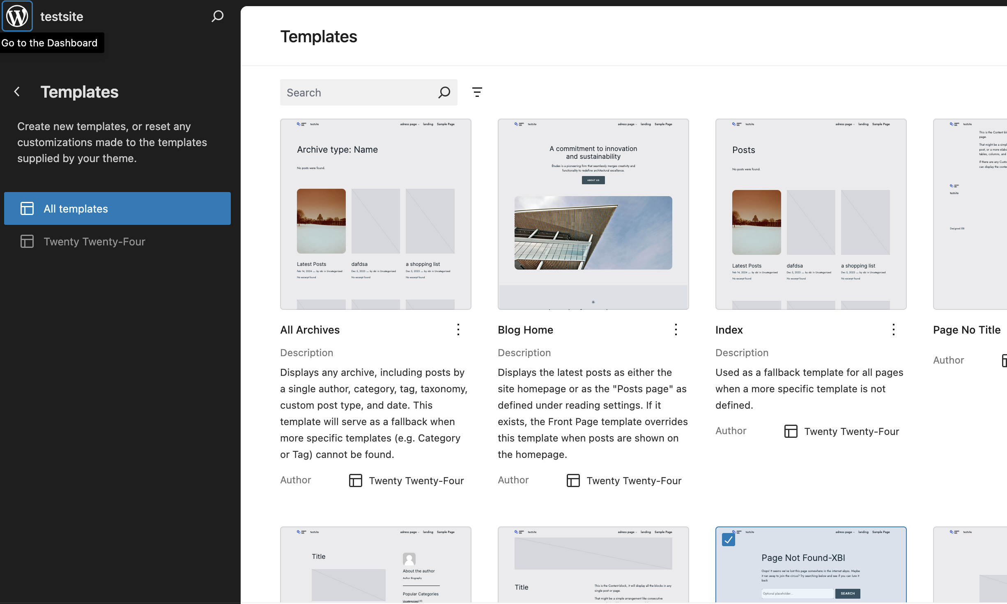
Workshop -404 page- How to

Slide 18
Test your 404 page

Slide 19

Website security
Notes:
Wordfence plugin, https

Slide 20
Website Performance Optimization
key areas of website performance optimization, such as optimizing page load speed, compressing images, and leveraging caching techniques.

Slide 21

Changing PHP settings with .htaccess
https://www.simply.com/en/support/faq/php/596/

Slide 22
Tools

Slide 23

PageSpeed Insights
Google’s Mobile-Friendly Test

Slide 24

Mobile Optimization
The significance of mobile optimization in today's digital landscape.

Slide 25
Discuss mobile-responsive design, mobile site speed optimization, and the importance of mobile-friendly multimedia content.

Slide 26
A look into future -> Google SGE
https://youtu.be/dVsiusLQy5Q?si=22Zlp2LutMWZmTEw

Slide 27
Work in Groups and find out how to do in WP
Optimize Images
Protect Your Website From Malware
Invest in Accessibility
Source
https://wp-rocket.me/blog/technical-seo-wordpress/?utm_source=chatgpt.com#section-18

Slide 28

Questions for today?

Slide 29
Reference
1
https://www.wpbeginner.com/beginners-guide/technical-wordpress-seo-framework-checklist/#aioseo-3-make-sure-your-website-is-secure-with-https
2
https://wp-rocket.me/blog/technical-seo-wordpress

